Slide 1

Workshop: Swarming Robots
May, 2019
David Saunders

Slide 2
Learning Objectives
In this workshop you shall:
Improve confidence of using the Greenfoot environment
Develop understanding of key features of Objective Oriented Programming
Learn about Swarm Robotics, specifically understanding and implementing your own projects.

Slide 3
Student Prerequisites
Basic prior knowledge about programming. (Essential)
Previous experience with Java and Greenfoot, Scratch, or similar IDEs. (Essential)
Interest in Computer Science, Swarm Robotics, and nature. (Recommended)
Notes:
Is this for students or the teacher to see?

Slide 4
Introduction
Before we go any further what exactly is Swarm Robotics?
Does anyone have any ideas?

Slide 5
Definition from Wikipedia
“Swarm robotics is an approach to the coordination of multiple robots as a system which consist of large numbers of mostly simple physical robots. It is supposed that a desired collective behavior emerges from the interactions between the robots and interactions of robots with the environment.”

Slide 6
Swarm Robotics
They key features of swarm robotics are:
Simple agents.
Communicate and work together.
Straightforward algorithms.
Nature inspired.
Notes:
Swarming Robots emphasise the use of many relatively simple robots or “agents” that communicate and work together to complete a variety of tasks.
Decentralized control.
Algorithms that govern the interaction between robots are relatively straightforward
Even to people with little experience in the field can get a grasp.

Slide 7
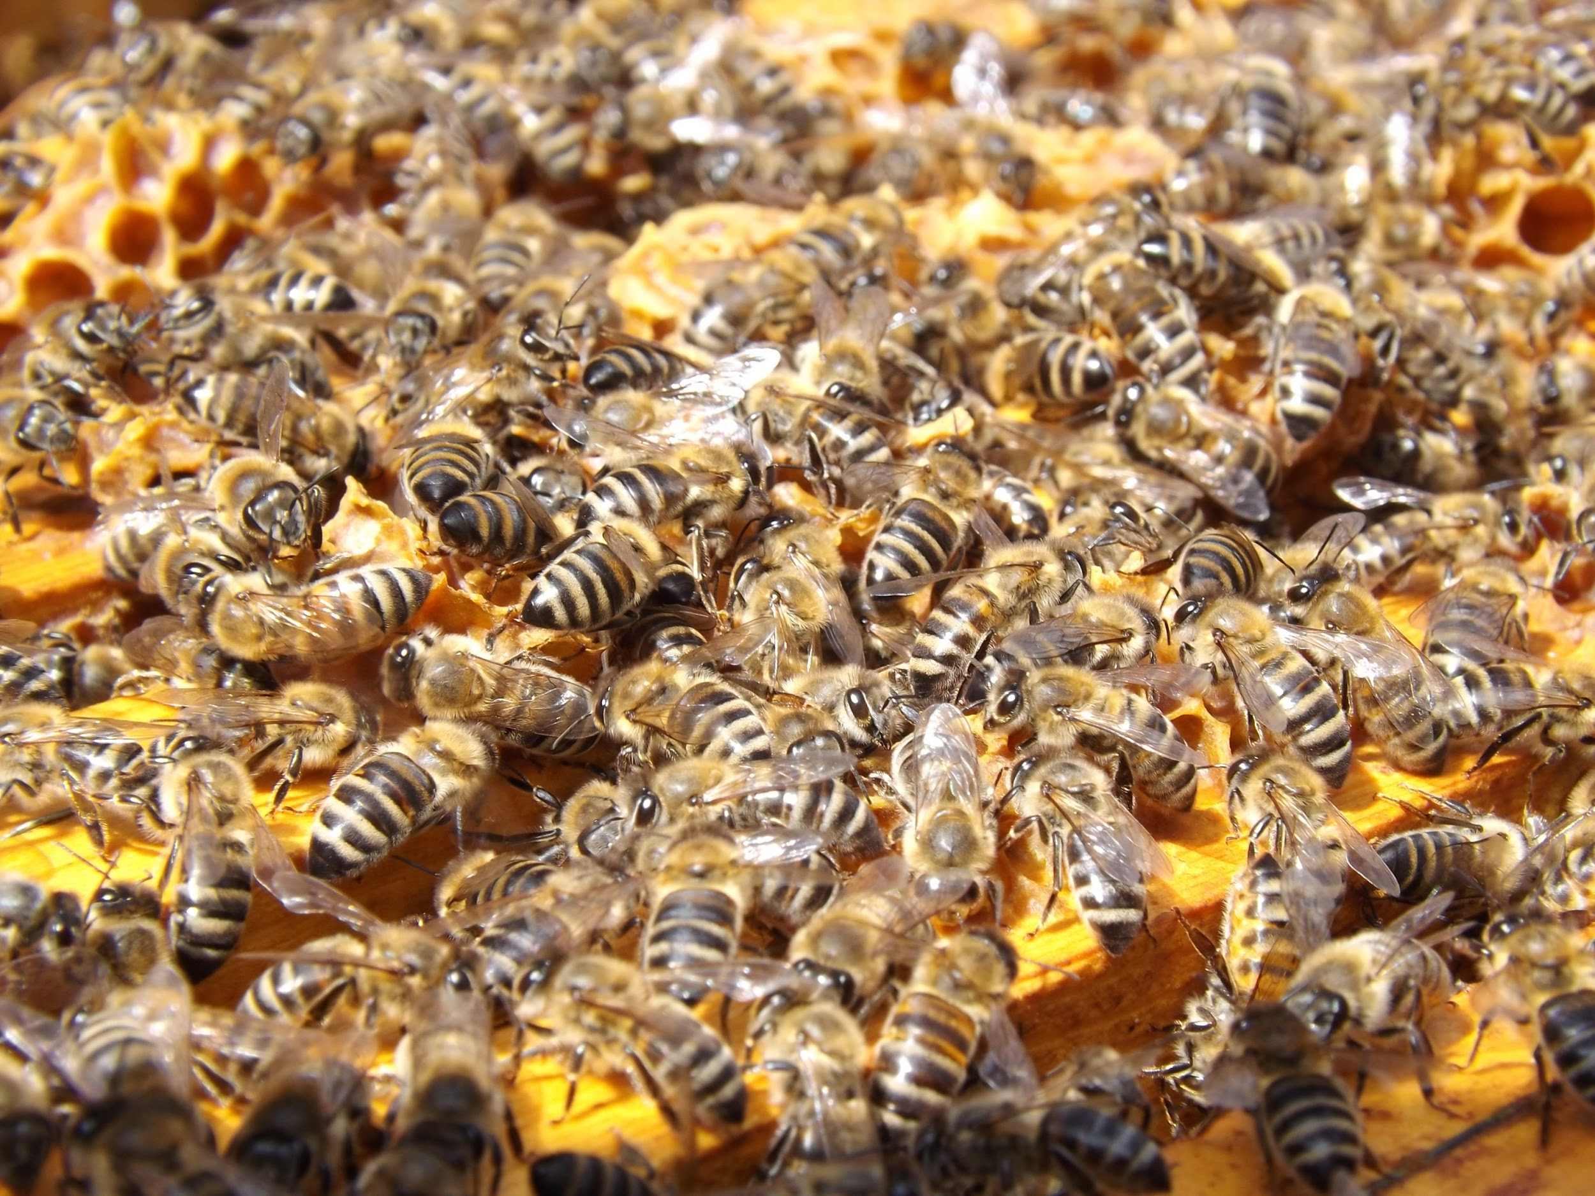
Nature Examples
Bees
Ants
Fireflies
Birds
Fish
All of these animals follow the principles of swarm robotics

Slide 8
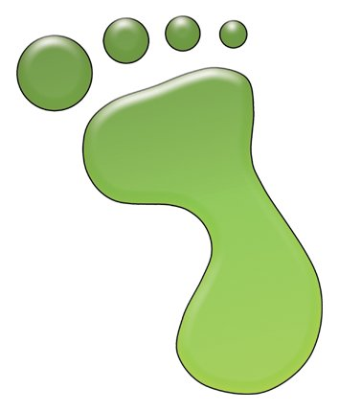
What is Greenfoot?
What is Greenfoot?
Educational software designed to make learning programming easy and fun.
Everyone here should already be familiar with Greenfoot.

Slide 9
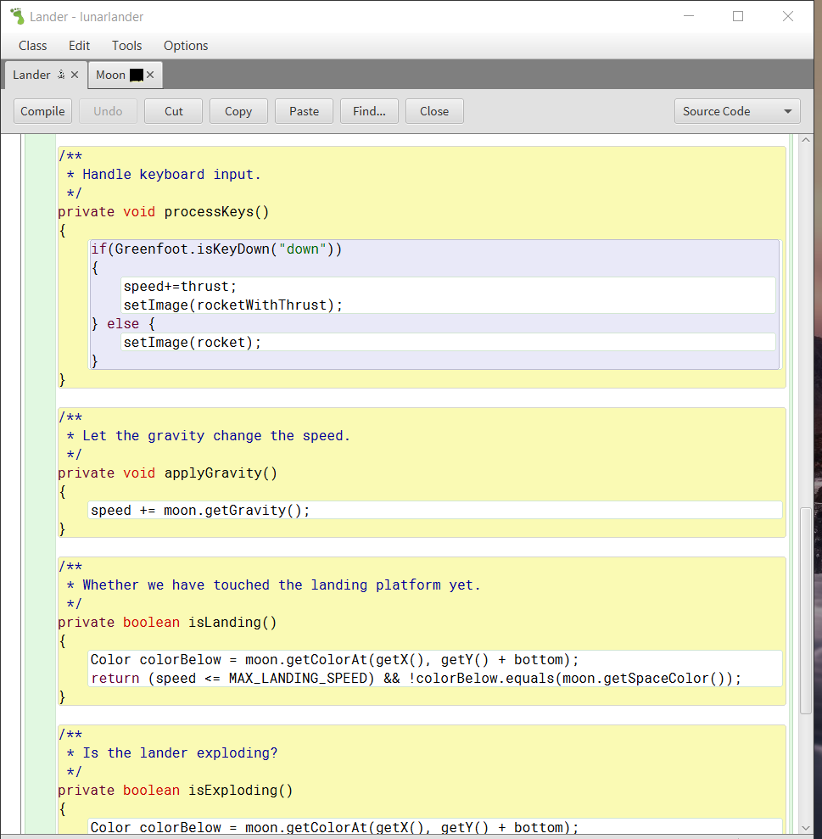
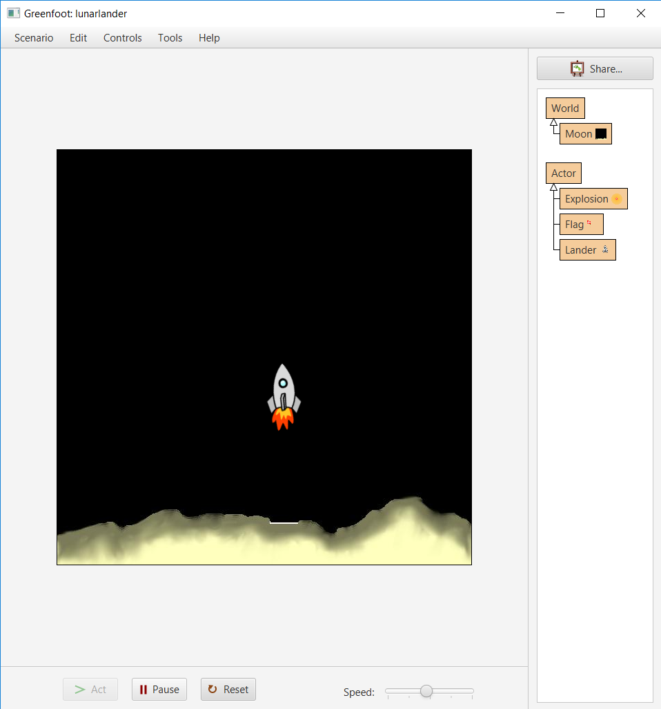
Greenfoot Recap
Interactive
Visual tools coupled with programming, making learning to program easier
Real Programming
Learn and teach Java, one of the most popular languages in the world

Slide 10
Greenfoot - What do you need to know?
Greenfoot is on the WJEC Computer Science GCSE.
Students must be able to:
“Design, write, test and refine Java programs within the Greenfoot environment”.

Slide 11
Object Oriented Programming Recap
Key aspect of modern programming.
It’s a way of thinking about data.
Class is a template or blueprint that describes an object.
Object is an instance of a class.
Inheritance is the idea of a class receiving characteristics from another class.

Slide 12
Example
Animal can be thought of as a class.
This class may have attributes such as eat or sleep.
Dog can be thought of as a sub or child class of animal.
This class would have the eat and sleep attributes from its super or parent class but also have attributes unique to dogs like bark or woof.
A dog you know, e,g, “Fluffy” can be thought of as an object as it is an instance of the dog class.
However it's not just dogs that can be represented with objects

Slide 13
Swarming Robots Algorithms

Slide 14
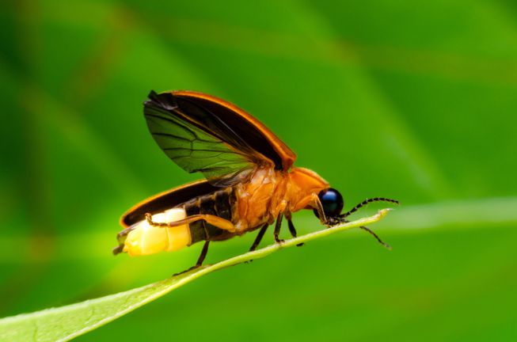
Firefly
Fireflies are insects native to Borneo and Southeast Asia. They use bioluminescence to make their abdomen produce light and flash periodically. Over time a collection or swarm of fireflies will begin to flash in synchrony.
Flashing together produces more light and is more likely to attract other flies for mating purposes.

Slide 15
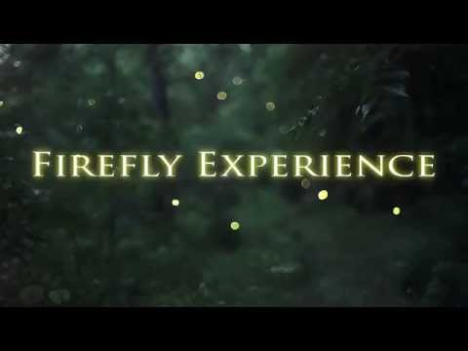
Firefly

Slide 16

How does it work?
Each firefly has a clock, visible only to itself.
This value can range from 1 to 12, so it can be thought of an analogue clocks hour hand. The clock for each firefly constantly increases by 1. It resets back to 1 after the value has reached 12.
When the clock hits 12 the firefly will flash and stay that way until the clock value resets to 1.

Slide 17
How does it work?
If a firefly sees another firefly flash at a different time from itself, then it should increase its clock twice.
If every firefly in a swarm does this then over time they will begin to synchronise as their clocks start to “catch each other up”. This is known as emergent behaviour, as it emerges over time.

Slide 18
Firefly Synchronisation Pseudocode
To start with every fly is assigned a random number for its clock.
Count from 1 to 12 repeatedly in a cycle
When the count is greater than 12 flash
If another firefly flashes when you’re not flashing then increase counter by 1
That's it!

Slide 19
Fireflies in action
Greenfoot Firefly Synchronisation:
https://www.greenfoot.org/scenarios/23759

Slide 20
Activity
Get yourself into groups of around 8 people.
You are now all fireflies. Pick a random number from 1 to 12. Instead of flashing you should raise your arm in the air.
The instructor shall clap every few seconds, to mark the passage of time.
You should begin to synchronise by following the firefly algorithm...
Be a firefly!

Slide 21
Activity Instructions
Count from 1 to 12 repeatedly in a cycle
When the count is greater than 12 flash
If another firefly flashes when you’re not flashing then increase counter by 1
Run this activity, see how long it takes you to synchronise.

Slide 22
Conclusion of Firefly Activity
This shows the key ideas of swarming robots.
Complex behaviours emerge from simple rules.
Each firefly can be thought of as an object, instances of a firefly class.
Now can you use your knowledge to implement the algorithms yourself?

Slide 23
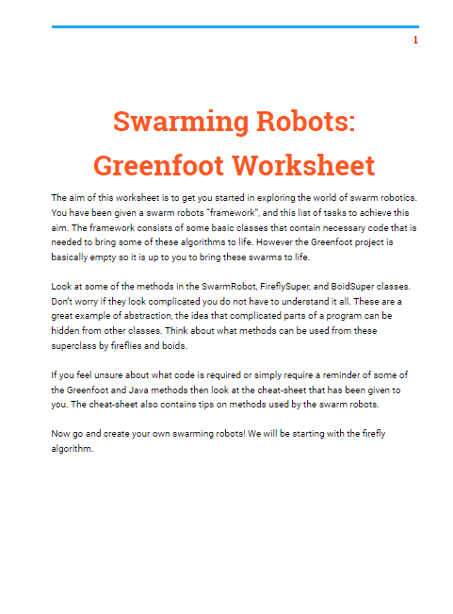
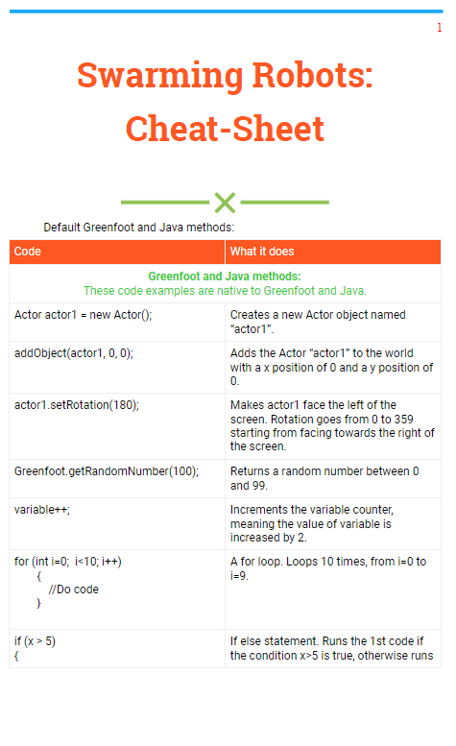
Worksheet
You should have your Worksheet and Cheat-sheet in front of you. Use these and the Swarming Robots Worksheet Greenfoot file to complete the first section of the Worksheet and learn!

Slide 24
Live coding
For any of you still struggling, the first section of the worksheet will now be completed live on screen. If there are any questions please do ask.
Well done for those who’ve finished. Hope you’re ready for another swarm robotics algorithm...

Slide 25
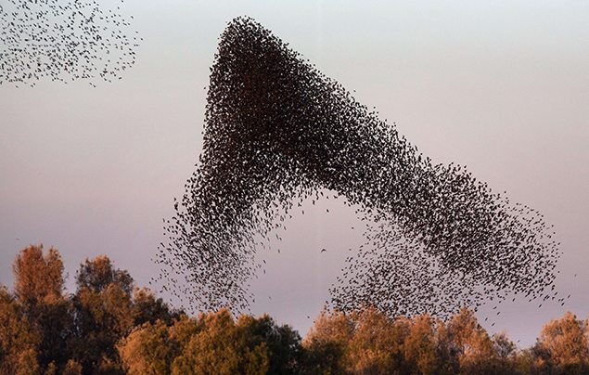
Birds
Many bird species, but in particular starlings tend to flock together in murmurations (swarms). Starlings are found worldwide but there are a They do this to protect against predators since they are stronger together rather than separately (safety in numbers).

Slide 26
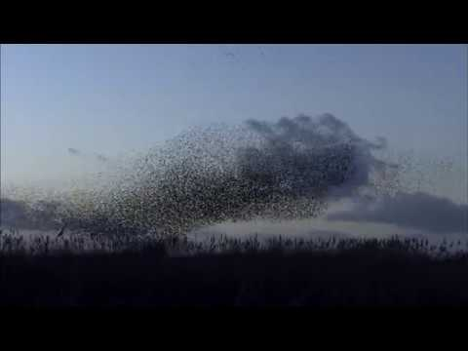
Starling Murmurations

Slide 27
Boids - How flocking works
Boid is short for “Bird-oid object”
Its an explanation for the flocking emergent behaviours seen across nature.
Relies on easy bird in the flock to follow 3 simple rules.

Slide 28
Boids PseudoCode
Turn towards the average of these 3 rules.
Alignment
Cohesion
Separation

Slide 29
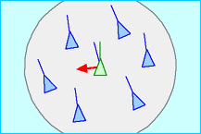
Alignment
Each bird should turn towards the average heading of nearby birds.
Pseudocode:
loop through neighbours of birds
add together all rotation of birds
divide by number of birds
update heading to average rotation of birds

Slide 30
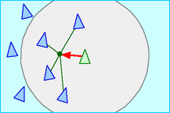
Cohesion
Each bird should turn towards the average position of nearby birds.
Pseudocode:
loop through neighbours of birds
add together all positions of birds
divide by number of birds
update heading to centre of birds

Slide 31
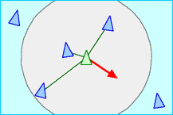
Separation
Each bird will turn to avoid nearby birds.
Pseudocode:
loop through neighbours of birds
add together all positions of birds
divide by number of birds
update heading opposite to centre of birds

Slide 32
Boids in action
Greenfoot Boid Flocking:
https://www.greenfoot.org/scenarios/23758

Slide 33
Boid Activity
First we need 4 volunteers to be birds.
Come to the front of the class and face a random direction.
Every time the instructor claps take a step forward ignoring the positions of other birds. What happens?
Now follow the next steps, resetting your position and direction between steps.
Be a bird!

Slide 34
Activity Instructions
Now follow the cohesion rule, to do this point your arm to the centre of the other birds and turn towards this direction before taking a step.
Still show cohesion but with your other arm point towards the average heading of the other birds, then turn towards the average of both arms directions before taking a step.
Still show cohesion and alignment, but additionally turn away from other birds and take a step backwards when you are touching them.

Slide 35
Conclusion of Boid Activity
It is unlikely that you were flocking properly as humans are not as good as birds, or swarming robots ar following the flocking rules.
The activity should have demonstrated the ideas of the algorithms and the emergent behaviours.

Slide 36
Worksheet
Go back to the worksheet, can you complete the final section and implement the boid flocking algorithm into Greenfoot?
Anyone stuck should ask for help, for extra help there will be live coding of this activity too.

Slide 37
Workshop Conclusion
What’ve we learned about?
Objects, Classes and ideas behind Object Oriented Programming.
Swarming Robots
Nature inspired algorithms.
Implementing pseudocode
Greenfoot

Slide 38
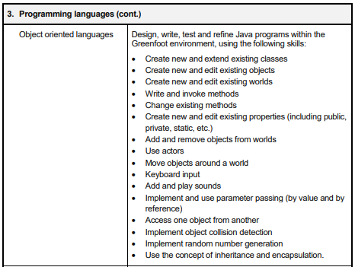
Greenfoot What You’ve Learned
This is what the WJEC expect you to know going into your exam.
Look at how much of this has been covered today!

Slide 39
Workshop Over!
Hope you’ve all enjoyed yourself and now have a better understanding of the tools and ideas used today.
Any questions?

